Slide 1
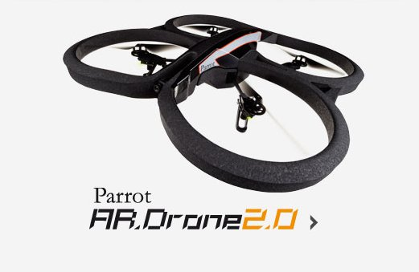
HexTree Planner: Basic Control Flow
Pre-processing
Start
UAV comm.
V-SLAM
process
process
VO
Inputs
Merge
State Estimator
IMU Acc.
Fusion
(UKF)
Read Sensors
Inputs
Data
NAV Vel.
Decision
Decision
Manual Input
Trajectory
Manager
Set Point
Position
Controller
Target
Achieved
Yes
Finish
Traj.
Coffee Mug
process
Inputs
process
Trajectory Controller
No
Yes
No
Finish

